Slide 1
Project :- Material Handling & Material Storage Systems
Name :- Akash Kumar Mishra
Roll no:- HPGD/JL21/2023

Slide 2
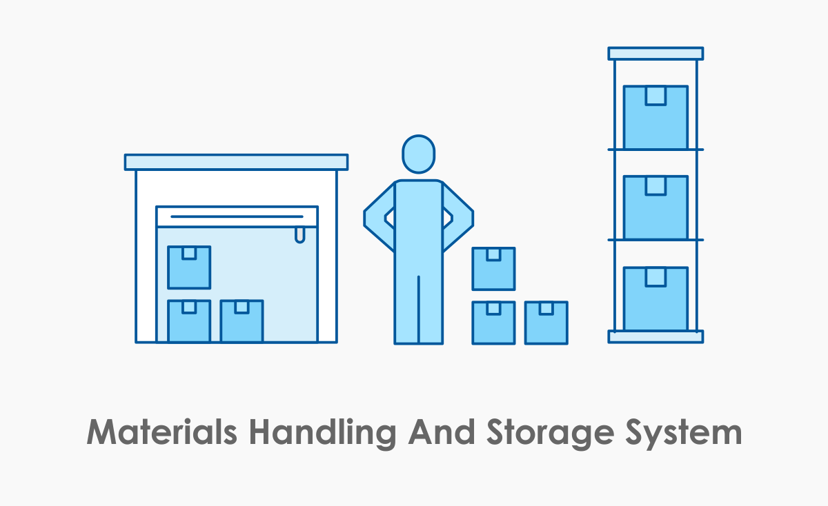
Definition
Material handling is defined as the movement, storage, control and protection of materials, goods and products throughout the process of manufacturing, distribution, consumption and disposal.
The function of a material storage system is to store materials for a period of time and to permit access to those materials when required.

Slide 3


Efficient material handling and storage play a crucial role in various industries for several reasons
Cost savings:- Efficient material handling and storage systems help minimize operational costs by reducing labor requirements, optimizing space utilization, and minimizing product damage or loss. Streamlined processes result in fewer errors, fewer delays, and lower inventory holding costs.
Improved productivity: Well-designed material handling systems increase productivity by ensuring smooth and timely movement of materials, reducing waiting times, and minimizing the risk of bottlenecks. This leads to improved throughput, shorter cycle times, and increased overall operational efficiency.

Slide 4

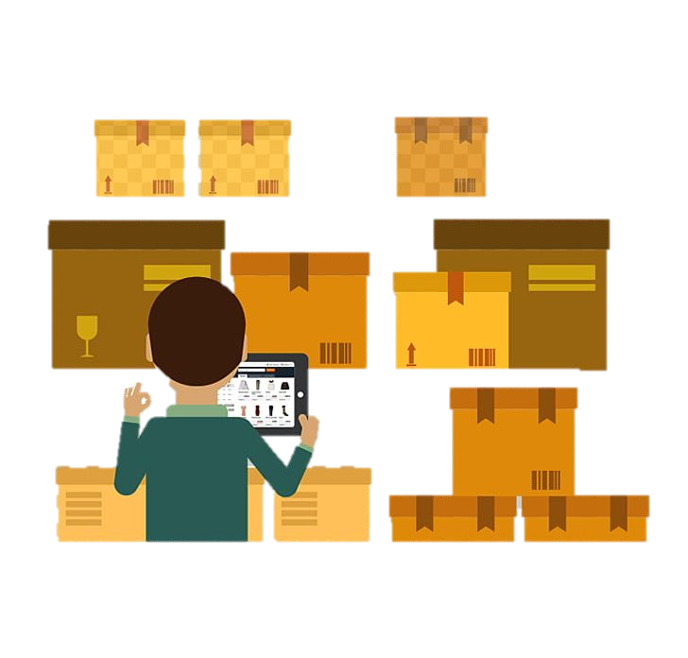
Contd…
Enhanced safety: Effective material handling and storage practices prioritize safety by reducing the risk of accidents and injuries. Proper equipment, ergonomic designs, and well-organized storage systems minimize the chances of accidents, such as slips, falls, or collisions. Safety measures contribute to a healthier and more secure work environment for employees.
Inventory management: Efficient material handling and storage enable accurate inventory management. By implementing appropriate tracking and control mechanisms, businesses can optimize inventory levels, reduce stockouts, and prevent overstocking. This improves order fulfillment, minimizes excess inventory costs, and enhances customer satisfaction.

Slide 5

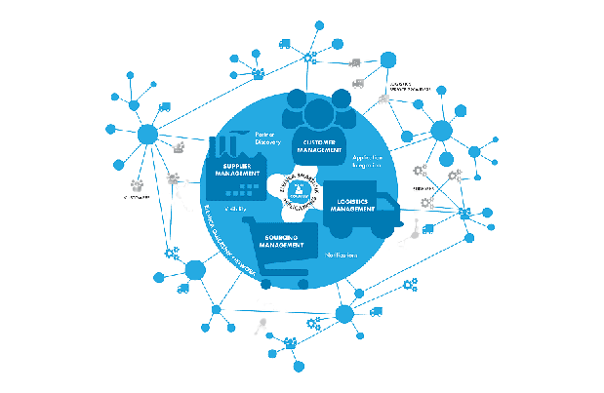
Contd..
Space utilization: Efficient storage systems make the most of available space, allowing businesses to maximize storage capacity without compromising accessibility. Optimized space utilization helps reduce facility costs by avoiding the need for excessive storage space or additional facilities.
Supply chain integration: Effective material handling and storage processes facilitate seamless integration within the supply chain. When materials are properly handled and stored, they can be easily tracked, identified, and transported, enabling smooth coordination between suppliers, manufacturers, distributors, and customers.

Slide 6

Contd…
Customer service and satisfaction: Efficient material handling and storage contribute to better customer service and satisfaction. Quick and accurate order processing, timely deliveries, and reduced errors in product handling enhance the overall customer experience. Satisfied customers are more likely to become repeat customers and recommend the business to others.In summary, efficient material handling and storage systems are essential in various industries as they promote cost savings, productivity improvements, safety, inventory management, space utilization, supply chain integration, and customer satisfaction. By optimizing these aspects, businesses can gain a competitive advantage and achieve long-term success.

Slide 7
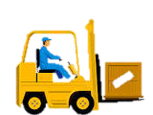
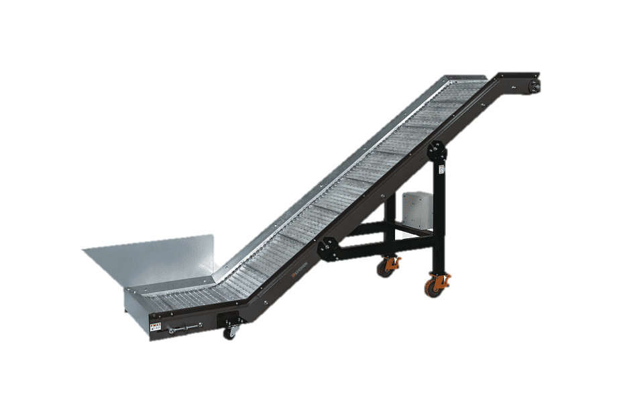
Common material handling equipments
Forklifts: Forklifts are widely used for lifting and moving heavy loads over short distances. They have two forks at the front that can be raised and lowered to lift and transport pallets, crates, and other materials.
Conveyor belts: Conveyor belts are used to transport materials horizontally or at an incline. They consist of a continuous belt that moves over rollers or pulleys, allowing goods to be transported smoothly and efficiently.
Pallet jacks: Pallet jacks, also known as pallet trucks or pump trucks, are used to lift and move pallets. They have two forks that slide underneath the pallet, which can then be lifted by pumping a hydraulic lever.

Slide 8
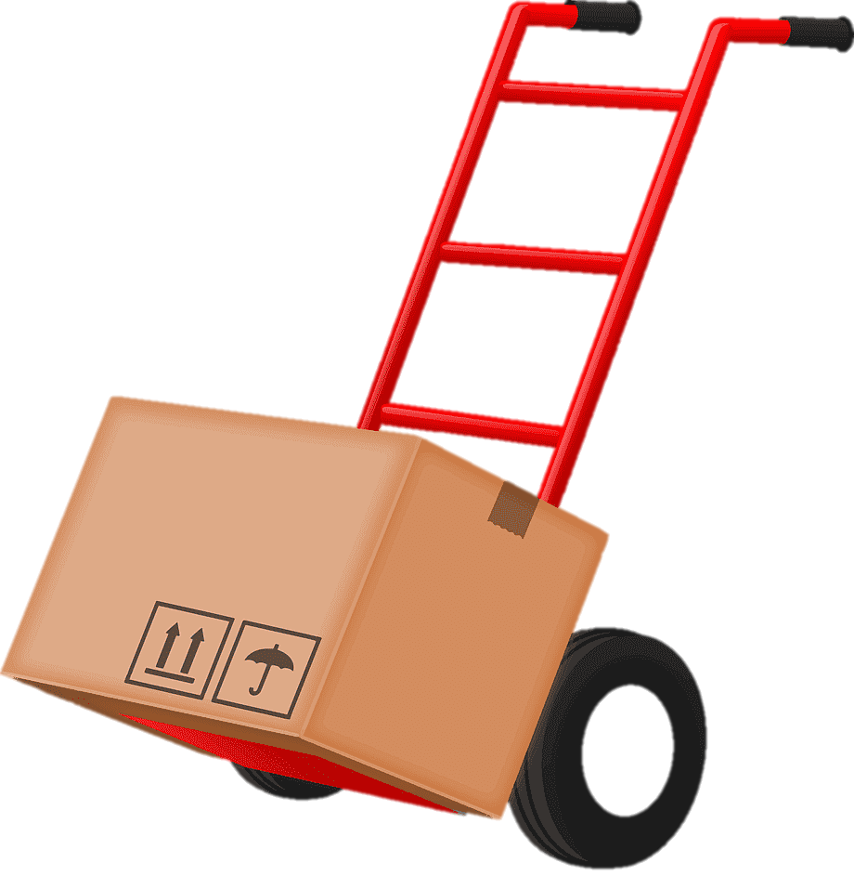
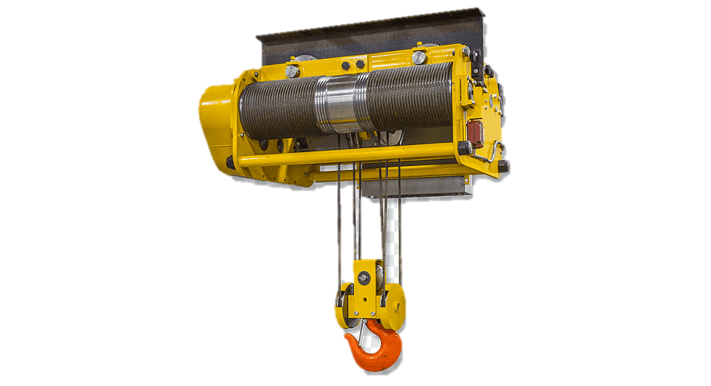
Contd..
Hand trucks: Hand trucks, also known as dollies or sack trucks, are used to transport smaller loads. They consist of a small platform or frame with wheels and handles, allowing users to easily move objects by tilting and pushing.
Automated guided vehicles (AGVs): AGVs are robotic vehicles used for material handling tasks. They can be programmed to move autonomously within a facility, transporting goods between different locations.
Hoists: Hoists are devices used to lift and lower heavy objects vertically. They can be manual or powered and are commonly used in construction, manufacturing, and warehouse settings.

Slide 9
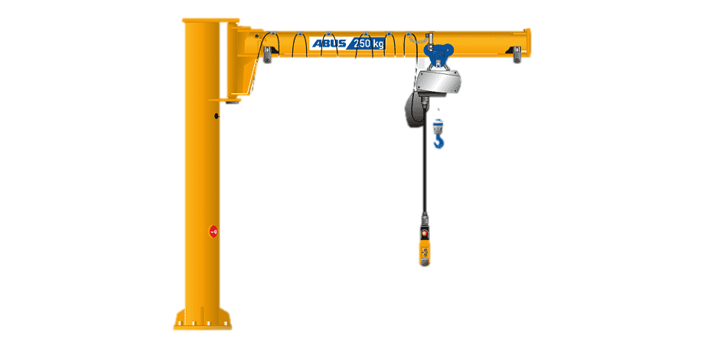
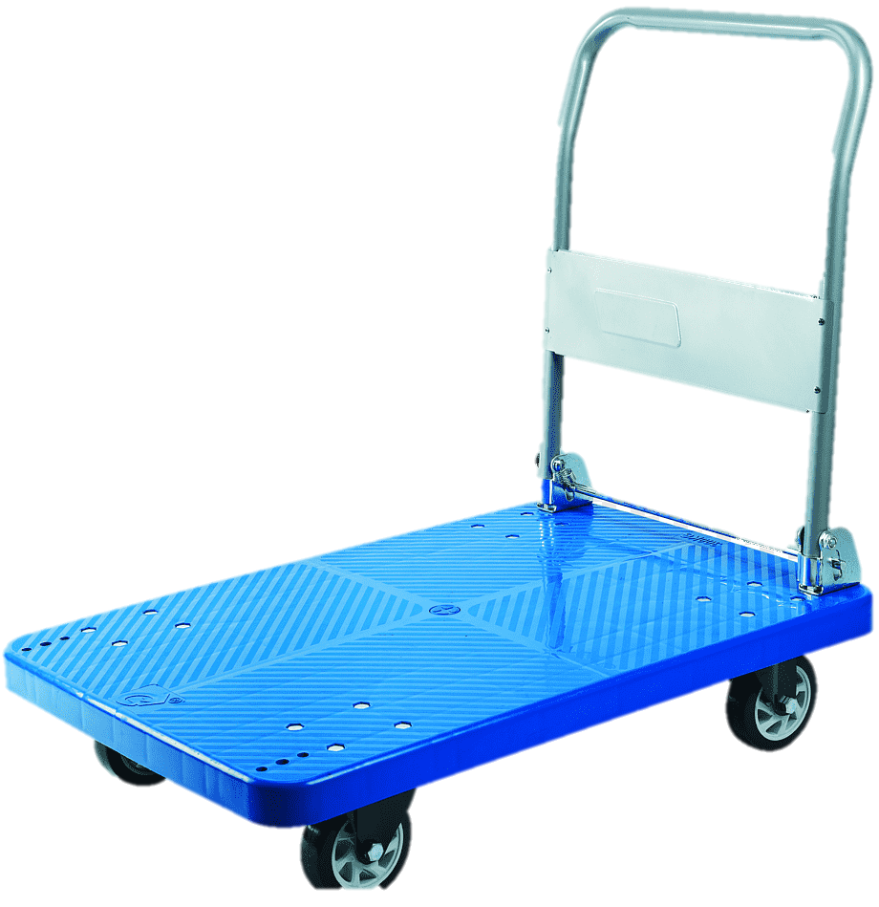
Contd…
Racks and shelves: Racks and shelves are storage systems that provide organized and efficient material handling. They are commonly used in warehouses and distribution centers to store pallets, bins, and other items.
Cranes: Cranes are used to lift and move heavy loads vertically or horizontally. They are typically equipped with a hoist, ropes or chains, and a boom or jib for reaching different areas. Cranes come in various types, such as overhead cranes, tower cranes, and mobile cranes.
Trolleys and carts: Trolleys and carts are wheeled platforms used for transporting goods within a facility. They come in various sizes and configurations, including pushcarts, platform trucks, and utility carts.

Slide 10
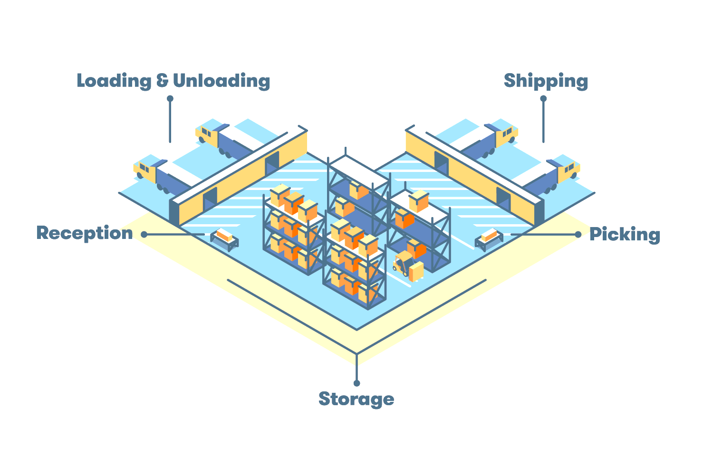
Warehouse Layout and Design
Warehouse layout and design refers to the strategic arrangement of storage areas, equipment, and workflow within a warehouse facility. It aims to optimize space utilization, improve operational efficiency, and enhance productivity. An effective warehouse layout considers factors such as inventory requirements, material handling equipment, order picking methods, and safety regulations. It involves determining the optimal location for receiving, storage, picking, packing, and shipping areas, as well as establishing efficient pathways for the movement of goods and personnel. A well-designed warehouse layout can result in streamlined operations, reduced costs, faster order fulfillment, and improved customer satisfaction.

Slide 11
Material Storage Systems
Material storage systems are designed to efficiently and safely store various types of materials, such as raw materials, finished products, and supplies, in an organized manner. These systems play a crucial role in optimizing space utilization, inventory management, and overall operational efficiency in industries and warehouses.
Some of material storage system commonly used
Pallet Racking Systems
Shelving Systems
Bin Systems
Carousel system

Slide 12
Lean Principles in Material Handling
The lean principle in material handling focuses on minimizing waste and maximizing efficiency in the movement and storage of materials. It aims to eliminate unnecessary steps, reduce inventory, and optimize the flow of materials throughout the production or supply chain. By implementing lean principles, organizations can achieve improved productivity, reduced costs, and increased customer satisfaction.
Key elements of lean material handling include
Just-in-Time (JIT) Delivery
Kanban System
Standardization
Continuous Improvement
5S Methodology

Slide 13
Emerging Technologies in Material Handling
Emerging technologies in material handling are revolutionizing various industries by improving efficiency, safety, and productivity in handling goods and materials. Some of the notable technologies include
Automation and Robotics
Artificial Intelligence (AI)
Drones
These emerging technologies are transforming material handling operations across industries, offering significant improvements in efficiency, accuracy, and overall productivity. As technology continues to advance, we can expect further innovation and integration of these technologies to drive continuous improvements in material handling processes.

Slide 14
Environmental Considerations in Material Handling
Environmental considerations in material handling involve various practices and strategies aimed at minimizing the negative impact on the environment throughout the entire process of handling, storing, and transporting materials.
Sustainable Material Selection
Energy Efficiency
Waste Reduction
Emissions Control
Green Packaging
Water Conservation
By incorporating these environmental considerations into material handling practices, companies can contribute to sustainable development, minimize resource depletion, reduce pollution, and mitigate the overall environmental impact.

Slide 15
Challenges and Future Trends in Material Handling
Material handling refers to the movement, storage, control, and protection of goods and products throughout their lifecycle in various industries. It plays a crucial role in optimizing supply chain operations and enhancing productivity. However, material handling also faces several challenges and is subject to future trends that shape its development. Here's a short note on the challenges and future trends in material handling
Challenges in Material Handling : Automation, Safety, cost and integration.
Future Trends in Material Handling: Robotics and Automation, Artificial Intelligence (AI) and Machine Learning, Sustainability
In conclusion, material handling faces challenges such as automation, safety, cost, and integration. However, the future trends in material handling focus on robotics, automation, IoT, AI, sustainability, and immersive technologies. Embracing these trends can lead to more efficient, safer, and sustainable material handling operations.

Slide 16
Thank you

